Slide 1
Thesis proposal
Comparing Approaches to Create Time Series of LMs
Md Touhidul Islam

Slide 2
Agenda
Introduction
Research Goal
Literature review
Primary Results
Methodology
Data
Introduction
Goal
Literature
Data
Methodology
Results

Slide 3







Motivation
Some question's answers get change over time.
Which political party to support?
Which product to buy?
Where should I go on holiday?
Where to invest?
Which dating app to use?
Product
Pools
Business
Politics
Some Examples
Consumer Confidence index.
Political Polls.
Approval Rating.
Business Confidence Index.
Product approval rating.
Happy
Sad
Time
Introduction
Goal
Literature
Data
Methodology
Results

Slide 4
Motivation
Use of opinion or emotion:
Business
Consumer Analysis
Product Testing
Field Analysis
Demand Forecasting
Financial Market Analysis
Government
Policy impact measuring
Change in people's opinion
Planning better policy
Social
Education Policy and Planning
Environmental Conservation
Disaster Preparedness and Response
Introduction
Goal
Literature
Data
Methodology
Results

Slide 5

Motivation
Current Approach to detecting change in people opinion
Problem with survey:
Collecting data for survey is expensive.
It is hard to get large number of participants.
Human emotions are constantly changing rapidly. Especially, in the world of social media. By the time we get the survey results, the trend may have already changed.
Time-consuming data collection process
Introduction
Goal
Literature
Data
Methodology
Results

Slide 6
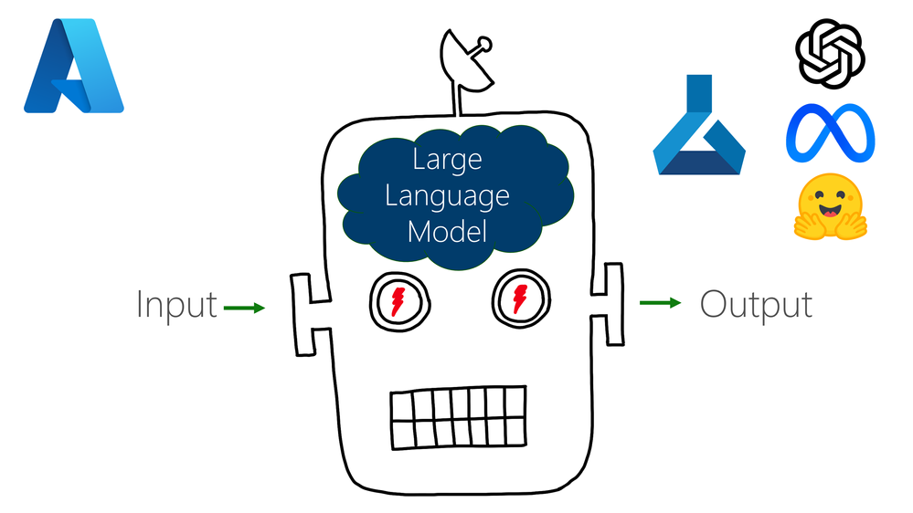

Language Model
Can we use LM and user-generated data to track the change in people's opinions?
If yes, Is it useable as an alternative to a survey?
If yes, What is the best approach to doing that?
LLM has gain huge knowledge from vest data.
We can further train them with social media data.
We want to see if is it a see changing opinion using LM.
Compare our result with existing methods to see, if it can outperform existing methods of creating time series from social media.
Introduction
Goal
Literature
Data
Methodology
Results

Slide 7
Research Question:
1. Can changes in people’s opinions/emotions be tracked using LMs trained on user-generated text, which can be used as an alternative to the survey?
2. If we can, what is the best approach to do it?
Introduction
Goal
Literature
Data
Methodology
Results

Slide 8

Motivation
Research Gap: Research seeks to determine whether LM can be used to track the change of emotion/opinion over time.
Research Goal: LMs to calculate a dominant emotion more accurately and calculate the changing patterns over time by training with data from different points in time.
Comment
Opinion
Review
Concern
Thought
Utilize user generated data
Use power of LM
Introduction
Goal
Literature
Data
Methodology
Results

Slide 9
Related work
Dynamics opinion detection
Dictionary-based sentiment analysis approaches
Time-aware language models
Introduction
Goal
Literature
Data
Methodology
Results

Slide 10
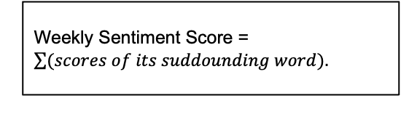
Related work
A target word is selected. example Merkel
Dictionary base approach
1
2
3
4
5
6
7
8
9
Among the weekly tweets, words around the target word within a specific window are selected
Each word is assigned a score from
-5 to -1
Negative = - 5 to -1
Positive = 1 to 5
AFINN contains more than 2000
(The AFINN lexicon is a list of English terms manually rated for valence with an integer between -5 (negative) and +5 (positive) )
Weekly Sentiment Score = $\sum{(scores of its suddounding word).}$
Time
Introduction
Goal
Literature
Data
Methodology
Results

Slide 11
Related work
Dictionary Approach: Problems
Judging from words alone can be challenging.
Sudden shifts in trade can have an impact.
Word meanings are constantly evolving.
Meanings are subjective and context-dependent.
Dictionary-based methods have limited coverage.
They ignore non-standard spelling and mistakes.
Every word is given the same weight.
For example, If I write, I don’t support Market,”. It will be predicted as a neutral sentence. Because it contains one positive word “Support”, and one negative word, “Don’t”.
Introduction
Goal
Literature
Data
Methodology
Results

Slide 12
Time-aware language models
Each model snapshot is trained on data from a distinct period, such as months or years, enabling it to capture the language and trends specific to that interval.
Use of TimeLM
Track language evolution: how language changes over time, especially on social media.
Trend analysis: Detects shifts in word usage, cultural references, or event-driven changes in language.
Temporal text classification: such as classifying tweets based on historical context.
Overall, TimeLM can perform tasks better when questions are being asked associated with that point in time.
For example, people's moods on COVID-19 can be best answered by a model trained on data at COVID-19 time.
Data Collection: TimeLMs uses large-scale Twitter data collected across multiple time periods to track how language changes over time.
Pretraining: The model is pretrained using masked language modeling on Twitter data from different snapshots to capture temporal language patterns.
Fine-tuning: It is fine-tuned for downstream tasks like sentiment analysis or event detection, leveraging its temporal knowledge.
Temporal Adaptation: TimeLMs can identify shifts in word meanings or trends by comparing data from different time periods.
Each model is fine-tuned on a separate dataset that represents a specific time period
In this research we will try to use the same approch but for diffierent purpose.
Introduction
Goal
Literature
Data
Methodology
Results

Slide 13



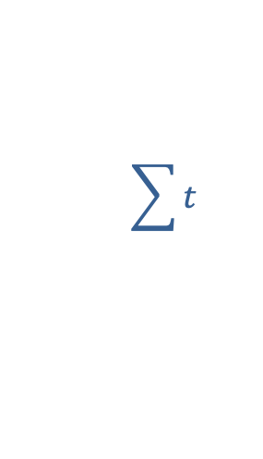
Related work
Sentiment base approach
1
2
3
4
5
6
7
8
9
10
11
All tweets containing target word
Target
$$\sum{t}$$
Score
Time

Slide 14
Related work
Potential temporal dynamic of social media and their problem
Sentiment Analysis:
Sometimes a question cannot be expressed in a single word
It only calculates positive or negative sentiment around a word
Notes:
sometimes a question cannot be expressed in a
single word. An example is the ”opinion of the British population on tax
hike in property”. Here, only one word like property or tax can’t capture
the entire question. Another problem is it only calculates positive or negative
sentiment around a word, but sometimes we need more than positive
or negative like happy, sad, angry, apathetic,

Slide 15
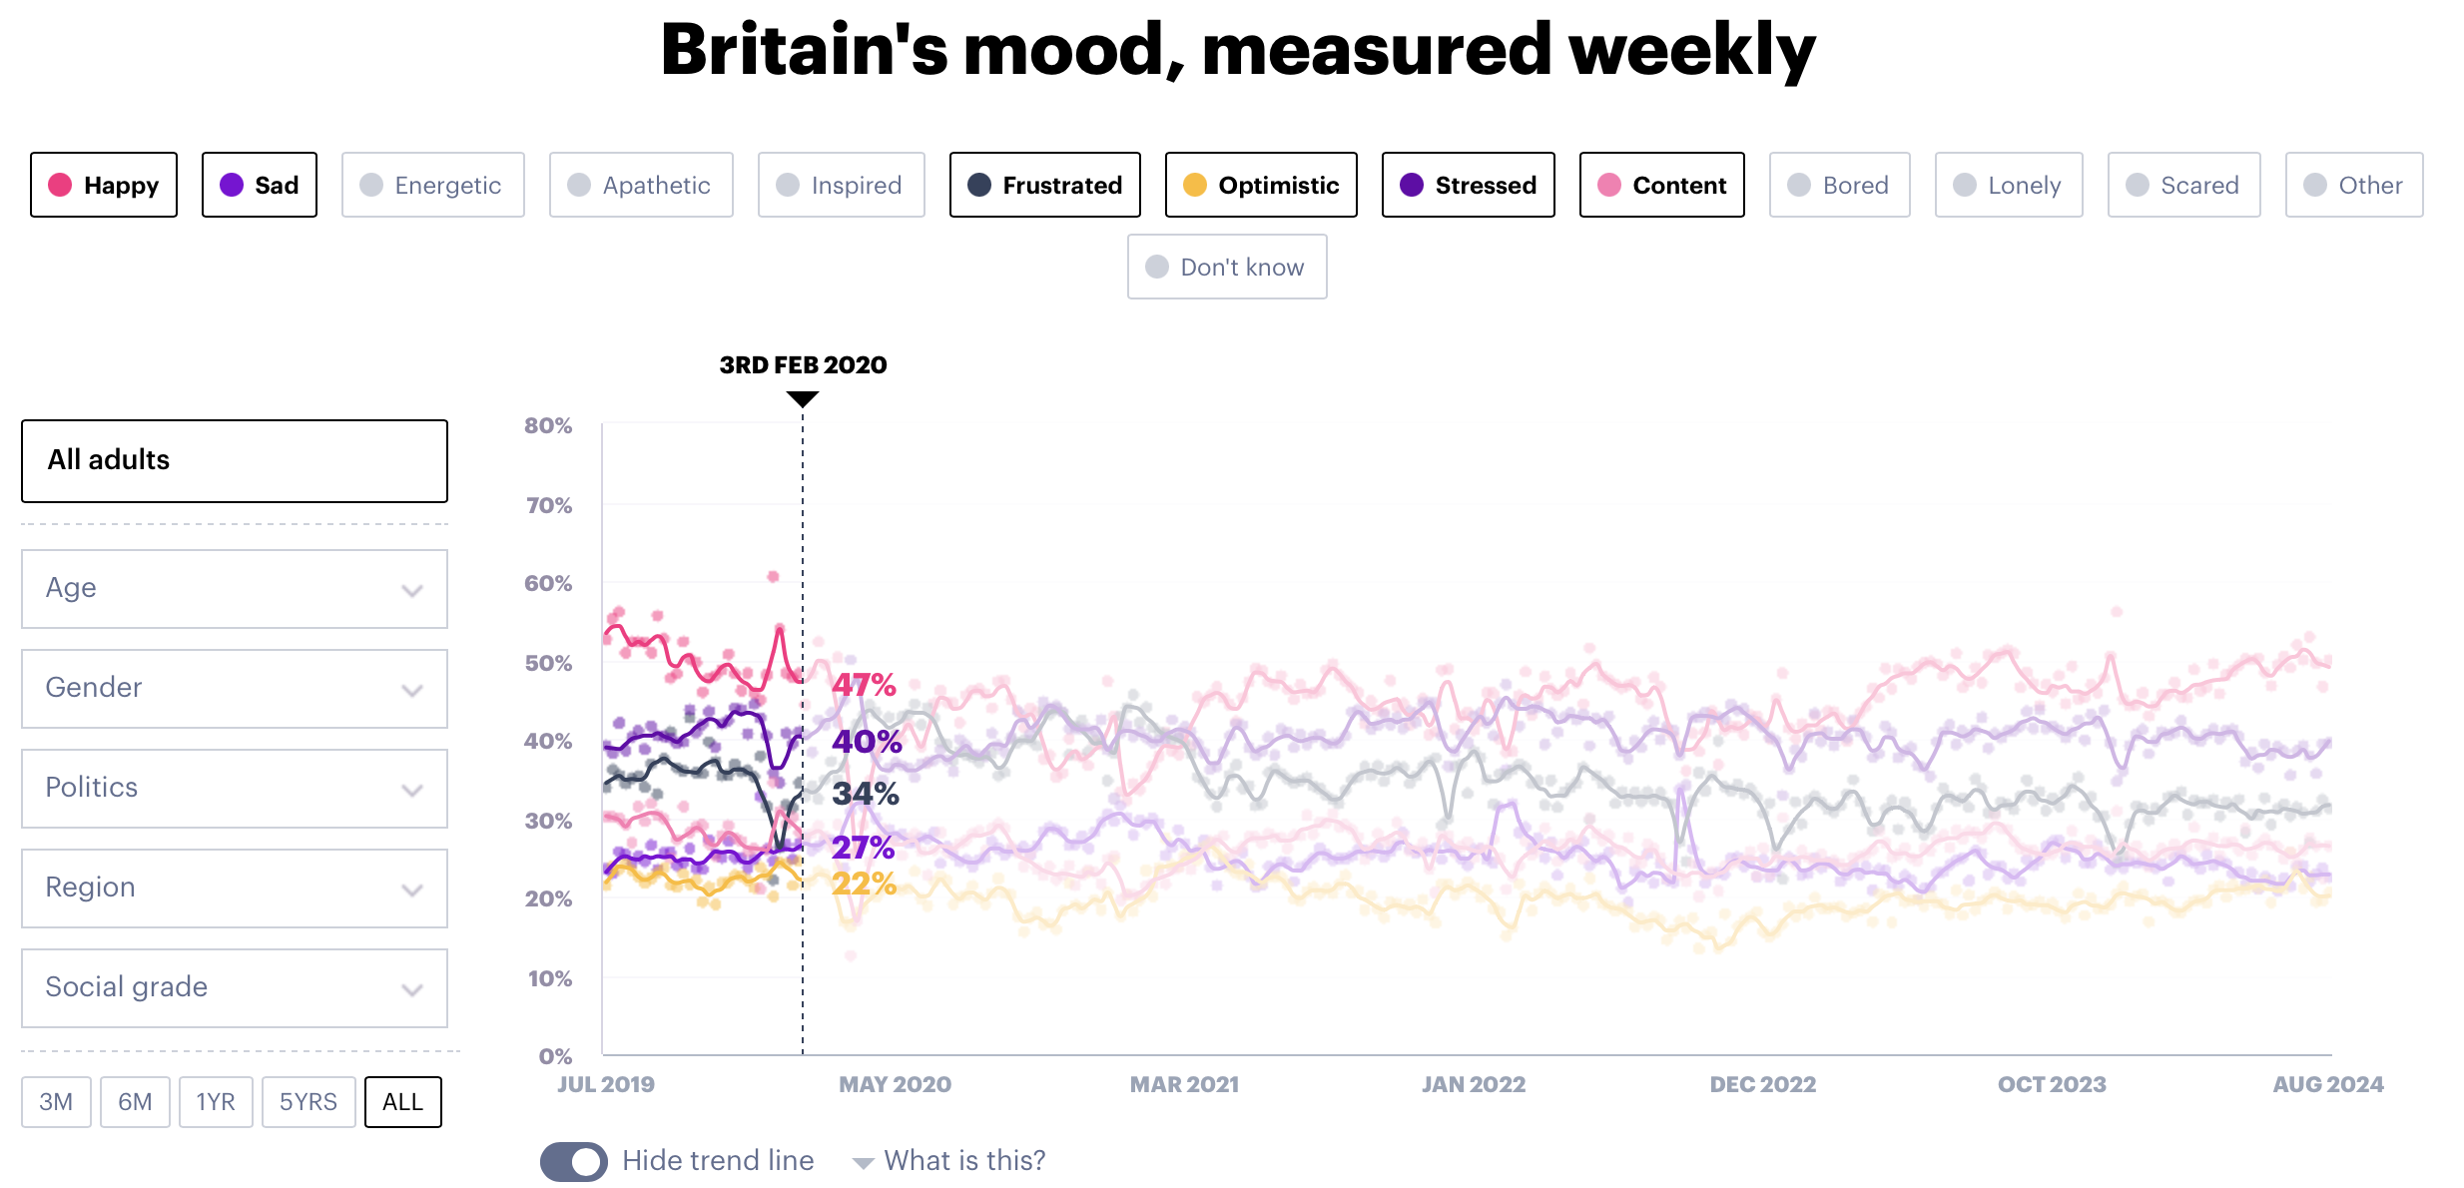
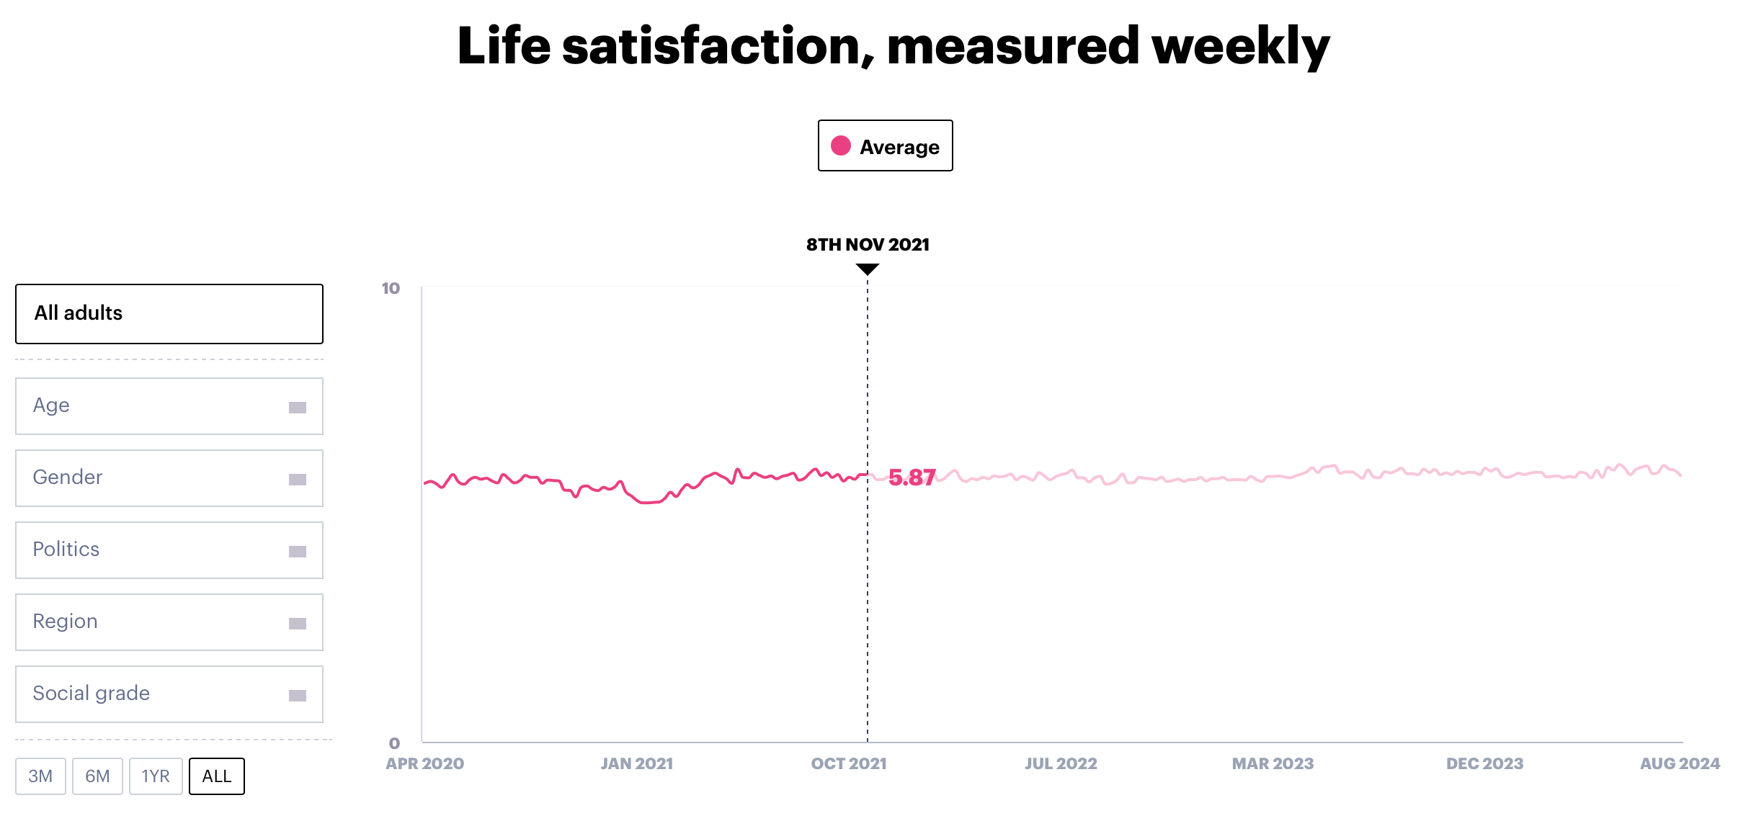
Survey Question (Gold standard)
Survey results are gathered from YouGov, which tracks the emotions and life satisfaction of the British population on a weekly basis.
Introduction
Goal
Literature
Data
Methodology
Results

Slide 16
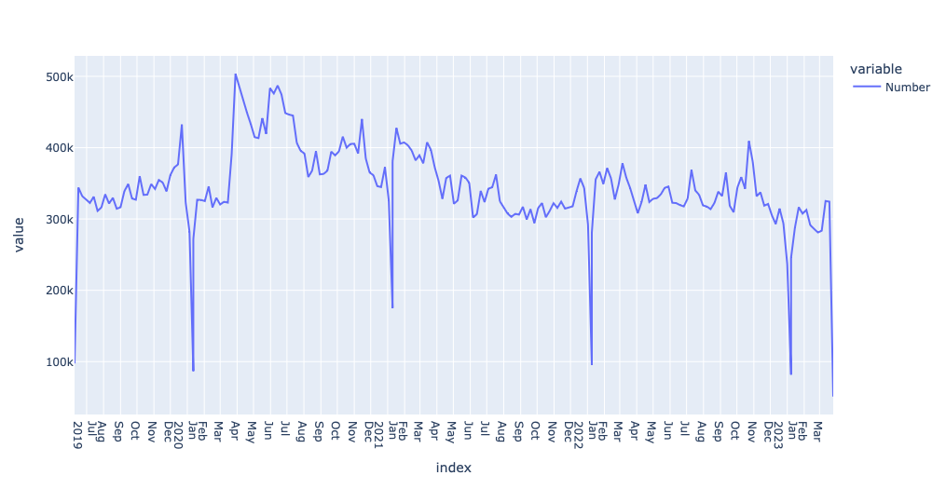
Data
The complete Twitter history of the users was extracted and split by week.
Time: UK Twitter users January 2019 – March 2023
Hight and low activity are filtered out
The data have been split into 200 weeks
Total 70 million tweets, with an average of 350 thousand weekly tweets
Time
Introduction
Goal
Literature
Data
Methodology
Results

Slide 17




Work Plan
Training Model:
Taking a pre-train model as a base model.
Preprocess data from all 200 different weekly tweets separately.
Train all 200 fresh models each with different weekly data.
Store all 200 models in Hugging face for next step analysis.
Different training approach:
Separate training
Cumulative training
Query Model:
Ask the same question to all differently trained models
Filter only those tokens we are interested.
Use probabilty for each token for the next stage.
Different Query approach:
Single Query for each Question.
Multiple Query for each Question.
Evaluation:
The model prediction will be compared visually against survey results.
Evaluation metrics correlation, permutation test, and Euclidean distance will be used to compare the results.
Different Re-scaling approach:
Min-Max Scaling
Standard scaling
Compare results from different approaches:
All different training, querying, and re-scaling approaches will be compared to determine the best approach.
Introduction
Goal
Literature
Data
Methodology
Results

Slide 18
Training Models
Pre-train Language Model
Stage 1: Taking a pretrain model as a base model. Because the about of data in a week is not enough to train model from stractch.
Stage 2: Preprocess data from all 200 different weekly tweets separately.
Data 1
Data 2
Data 3
Data 4
Data 5
Data 200
Stage 3: Train all 200 frash model each with different weekly data.
Train 1
Train 2
Train 3
Train 4
Train 5
Train 200
Model 1
Model 2
Model 3
Model 4
Model 5
Model 200
Stage 4: Store all 200 model in Hugging face for next step analysis.
Introduction
Goal
Literature
Data
Methodology
Results

Slide 19
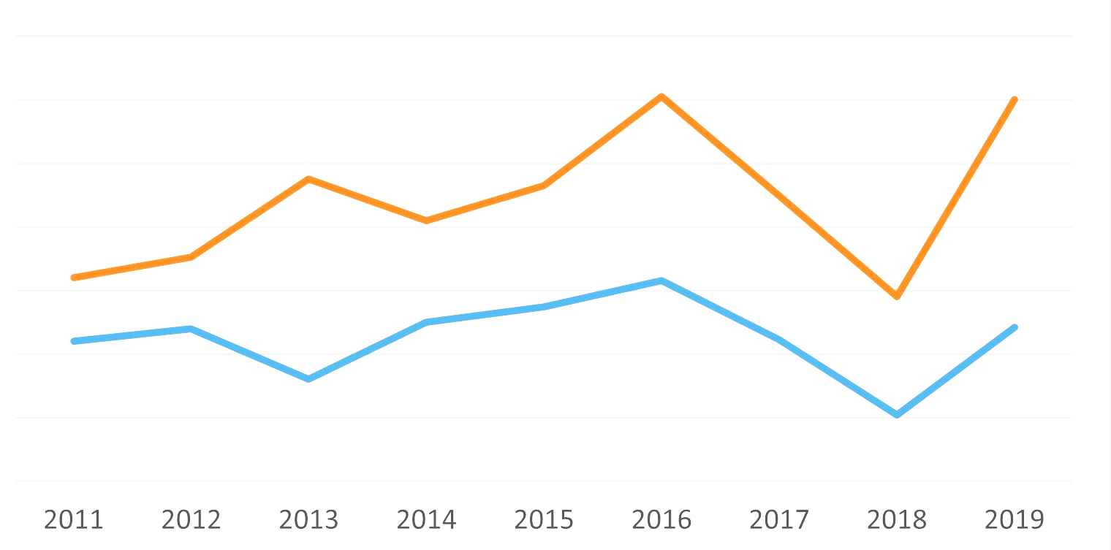
Separate Fine Tuning
Week 1
Model week 1
Week 2
Model week 2
Sad : 50%
Happy: 35 %
Not Sure: 14%
Week 3
Model week 3
Sad : 45%
Happy: 36 %
Not Sure: 17%
Pretrain Model
Week 4
Model week 4
Query
Sad : 48%
Happy: 37 %
Not Sure: 15%
Week 5
Model week 5
Sad : 49%
Happy: 39 %
Not Sure: 16%
……
…….
Sad : 46%
Happy: 36 %
Not Sure: 13%
Week 200
Model week 200
Introduction
Goal
Literature
Data
Methodology
Results

Slide 20
Cumulative fine Tuning
Pretrain Model
Week 1
Model week 1
Week 2
Model week 2
Sad : 50%
Happy: 35 %
Not Sure: 14%
Week 3
Model week 3
Sad : 45%
Happy: 36 %
Not Sure: 17%
Week 4
Model week 4
Query
Sad : 48%
Happy: 37 %
Not Sure: 15%
Week 5
Model week 5
Sad : 49%
Happy: 39 %
Not Sure: 16%
……
…….
Sad : 46%
Happy: 36 %
Not Sure: 13%
Week 200
Model week 200
Introduction
Goal
Literature
Data
Methodology
Results

Slide 21
Query Model:
Broadly speaking, <mask> is the emotion that best describes your mood and/or how you have felt in the past week.
Sad | Happy | Week
50% | 40% | 1
52% | 38% | 2
55% | 39% | 3
47% | 53% | 4
48% | 52% | 5
47% | 58% | 6
40% | 65% | 7
30% | 70% | 8
25% | 76% | 9
0% | 100% | 10
1
2
3
4
5
6
7
8
9
10
Sad
Happy
Time
Introduction
Goal
Literature
Data
Methodology
Results

Slide 22
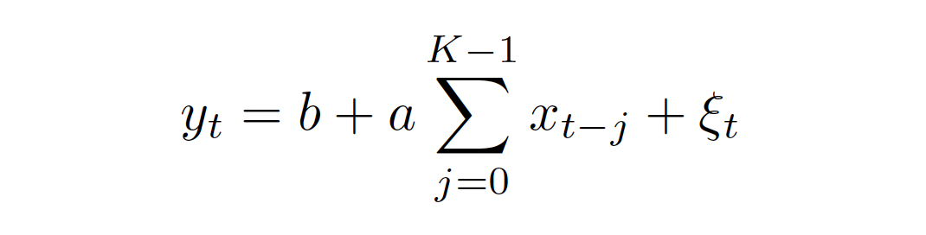
Evaluation
1. Correlation
yt = Survey outcomes
Xj = Weekly predicted ratios
k = A fixed hyperparameter.
Purpose: Measures the strength and direction of a linear relationship between two variables. A survey outcome is compared to the k-weekly text window.
Introduction
Goal
Literature
Data
Methodology
Results

Slide 23
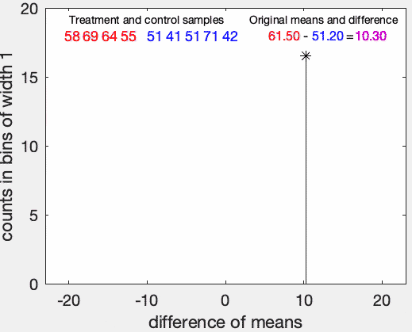
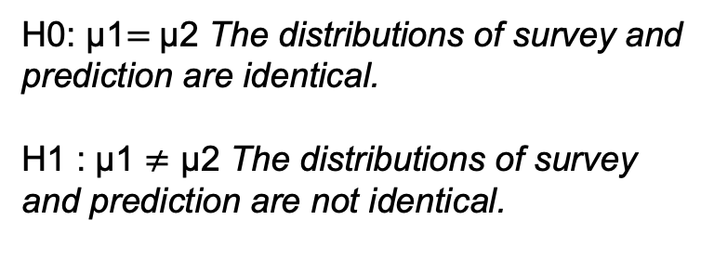
Permutation Testing
H0: μ1​$=$μ2​ The distributions of survey and prediction are identical.
H1​ : μ1 ​$≠$ μ2​ The distributions of survey and prediction are not identical.
Random Re-sampling: The data is randomly shuffled (permuted) many times to generate new samples. This helps test whether an observed result could be due to chance.
Test Statistic Comparison: The test statistic (e.g., mean difference) is calculated for each permuted sample and compared with the actual observed statistic. If the observed value is extreme compared to the permuted values, the result is considered statistically significant.
Mean difference original set vs. mean difference original set
Introduction
Goal
Literature
Data
Methodology
Results

Slide 24
Training Model's
Train by Twitter one billion tweets in 100 languages
100 billion user-tweet social engagement data covers 1 billion Tweets.
Pretrain Language Model: TwHIN-BERT
Data 1
Data 2
Data 3
Data 4
Data 5
Data 200
Total 70 million tweets, with an average of 350 thousand weekly tweets
Hyperparameter | Value
Train: | 80 %
Test: | 20 %
Mask probability: | 15 %
Epoch: | 10
Learning Rate | 5e-5
Train 1
Train 2
Train 3
Train 4
Train 5
Train 200
Model 1
Model 2
Model 3
Model 4
Model 5
Model 200
We have created 200 model that available publicly at:- huggingface.co/touhidulislam/
Introduction
Goal
Literature
Data
Methodology
Results

Slide 25
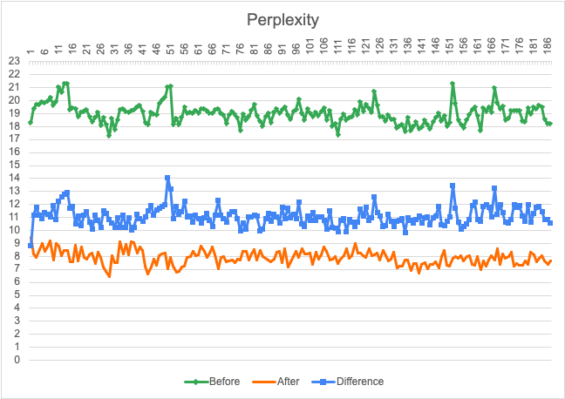
Do retraining have improve performance

Slide 26
Question and Option

Slide 27
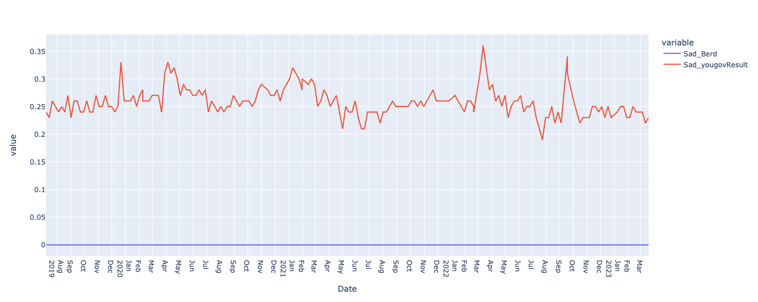
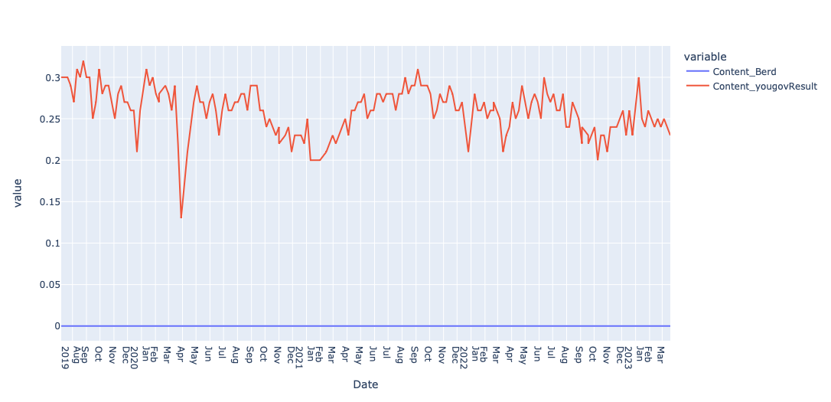
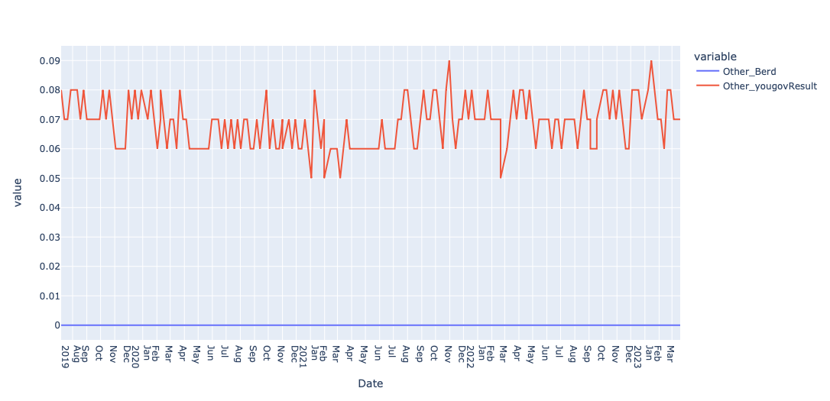
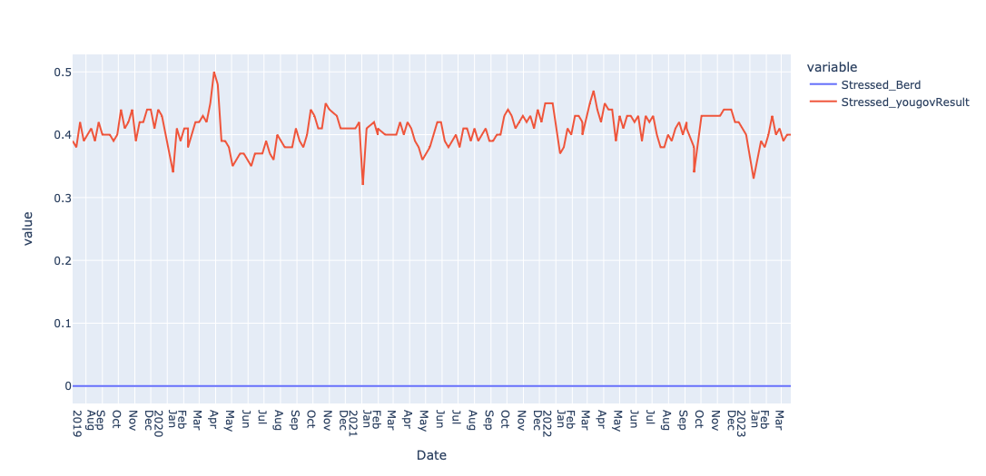
Before Rescaling
Broadly speaking, <mask> is the emotion that best describes your mood and/or how you have felt in the past week.
Survey
LM
Sad
Content
Other
Stressed
Introduction
Goal
Literature
Data
Methodology
Results

Slide 28
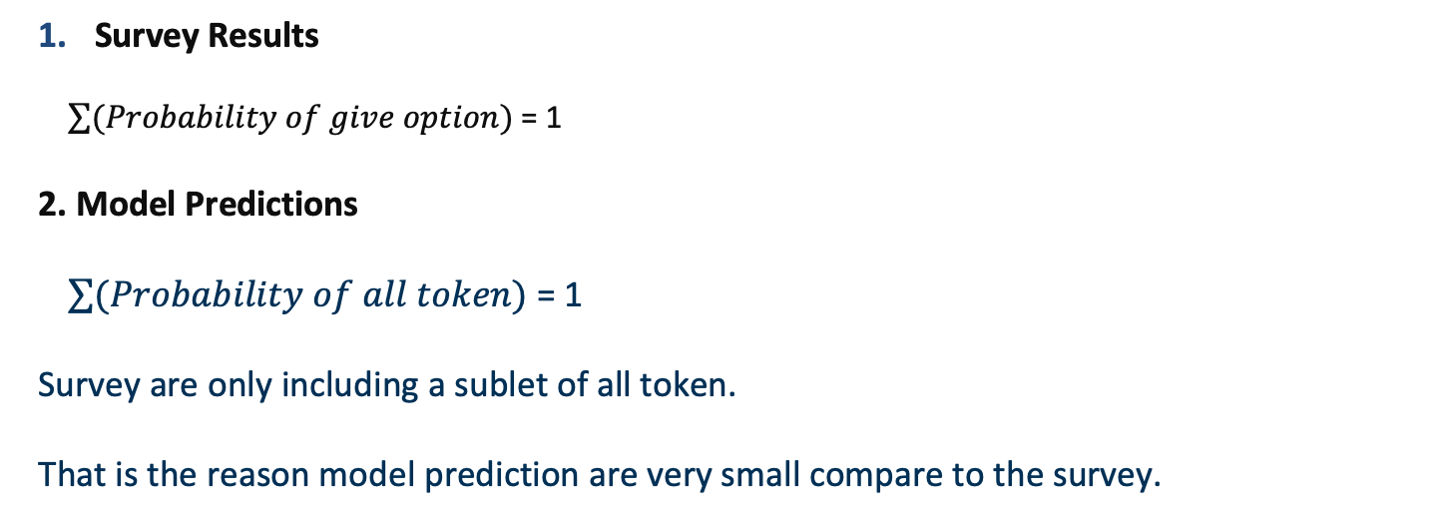
Possible reason behind the difference
Survey Results
$\sum{(Probability of give option)}$ = 1
2. Model Predictions
$\sum{(Probability of all token)}$ = 1
Survey are only including a sublet of all token.
That is the reason model prediction are very small compare to the survey.
Possible solution -> Rescaling
Introduction
Goal
Literature
Data
Methodology
Results

Slide 29
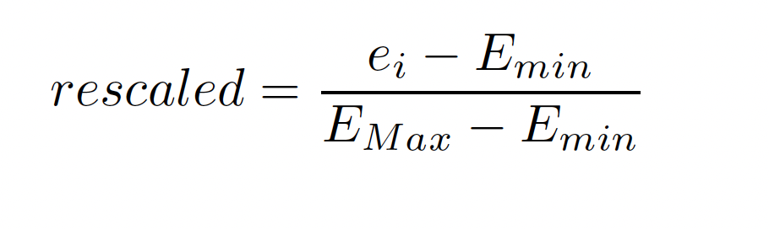
Rescaling
ei = prediction from the target at week i
Emin = minimum prediction from all target predictions at week i
Emax = maximum prediction from all target predictions at week i
So, the Max value in the array becomes 1 and the min value in the array becomes zero. All other values fall between 1 and 0.
Introduction
Goal
Literature
Data
Methodology
Results

Slide 30
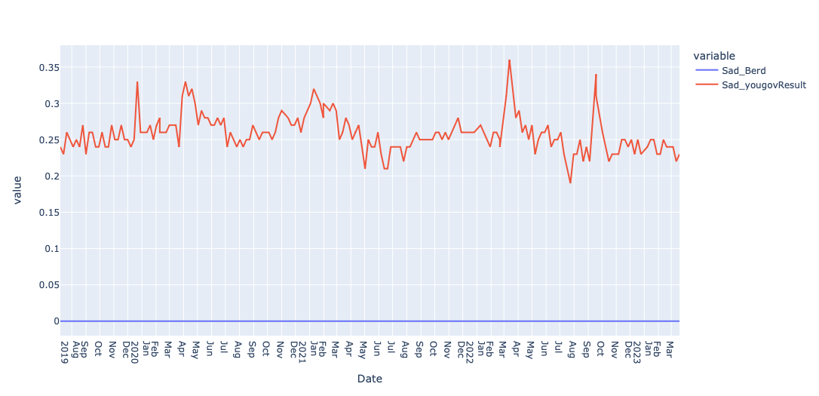
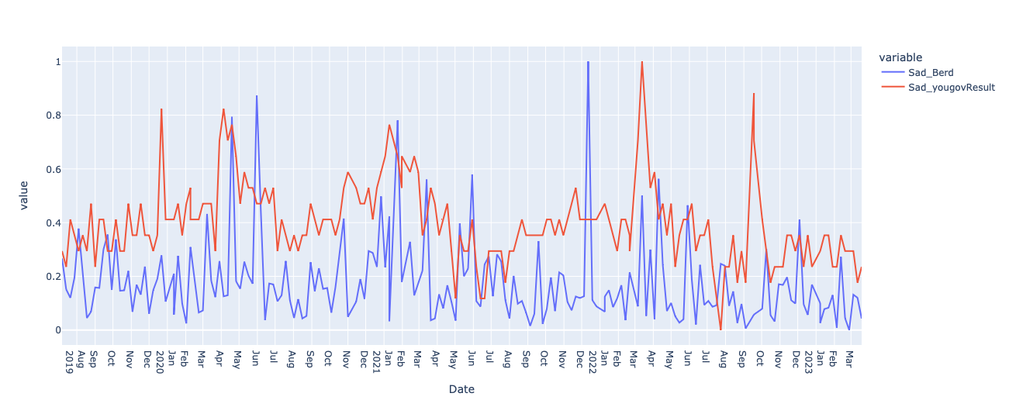
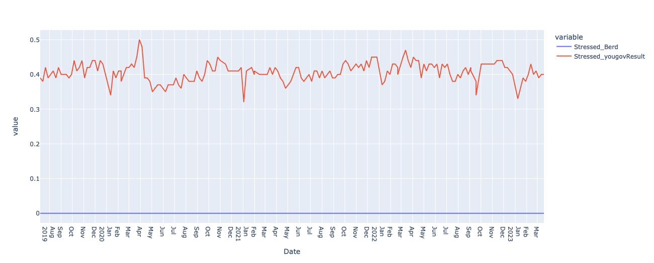
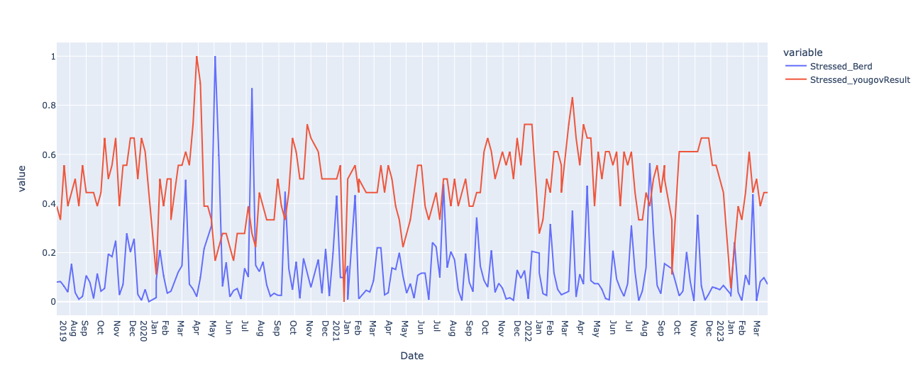
Rescaling
Survey
LM
Before
After
Sad
Stress
Introduction
Goal
Literature
Data
Methodology
Results

Slide 31
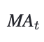
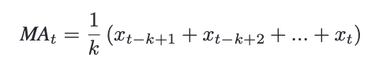
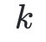
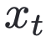
Rolling average
Moving Average Aggregate Sentiment
= Simple Rolling average
= Number of variables
= Value at position t
We have used a 3-week rolling average to compensate for sudden changes.
Introduction
Goal
Literature
Data
Methodology
Results

Slide 32
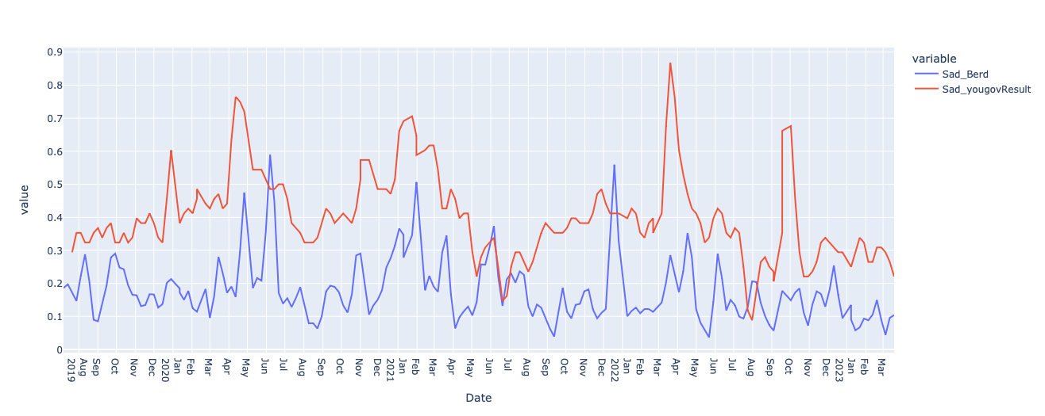
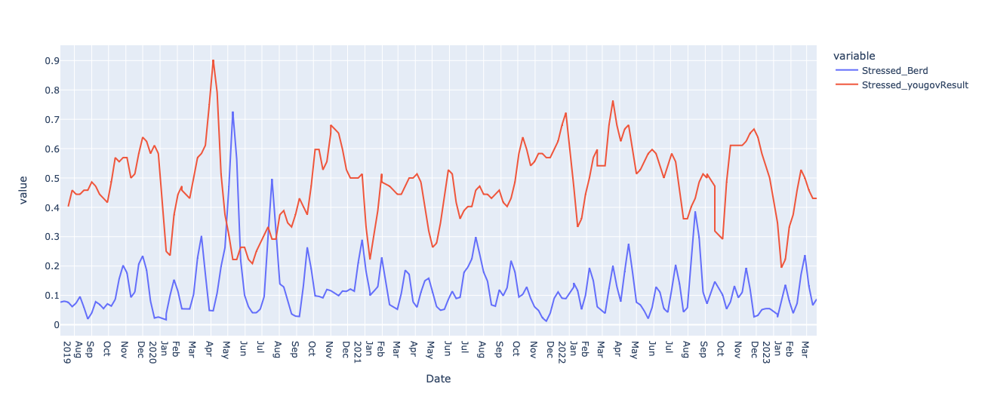
Applying moving average
survey
LM
Before
After
Sad
Stress
Introduction
Goal
Literature
Data
Methodology
Results

Slide 33
There is a problem still remains
The result is heavily dependent on the query. A simple change in query can change the result dramatically.
Possible Solution
Run the same query multiple time, with different writing style and get the average results
Introduction
Goal
Literature
Data
Methodology
Results

Slide 34
Average of Multiple queries
Broadly speaking, which of the following best describe your mood and/or how you have felt in the past week. Please select all that apply <mask>.
Broadly speaking, <mask> is the emotion that best describes your mood and/or how you have felt in the past week.
Broadly speaking, the emotion <mask> best describes your mood and/or how you have felt in the past week.
Broadly speaking, which of the following best describe your mood and/or how you have felt in the past week. Please select all that apply <mask>.
Hopefully, the variation due to queries will cancel out, if the number of queries is large enough
Introduction
Goal
Literature
Data
Methodology
Results

Slide 35
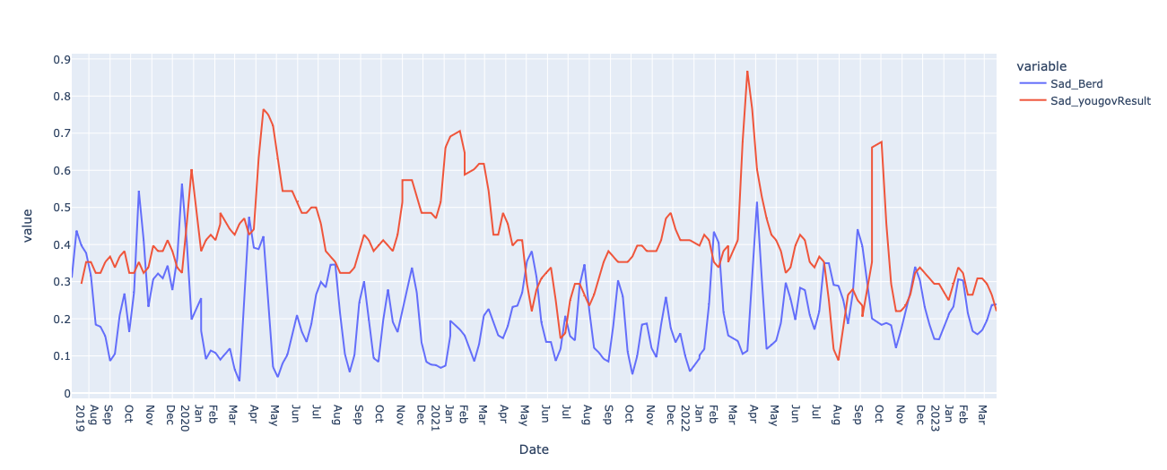
Averaging multiple queries
survey
LM
Before
After
Sad
Stress
Introduction
Goal
Literature
Data
Methodology
Results

Slide 36
Primary Result
 |  | Sad | Content | others | Stress | Lonely | Inspired | Frustrated | Optimistic | Bored | Average
Euclidean Distance | After | 3.615 | 3.631 | 0.964 | 5.671 | 2.462 | 1.305 | 5.026 | 2.838 | 3.325 | 3.484
 | Before | 4.077 | 6.640 | 6.228 | 5.806 | 5.644 | 6.230 | 6.984 | 6.086 | 4.436 | 5.792
 | Average | 3.527 | 6.377 | 5.747 | 5.450 | 5.174 | 5.911 | 6.688 | 5.684 | 3.844 | 5.378
Correlation | Before | 0.243 | -0.018 | -0.023 | -0.089 | 0.123 | 0.045 | 0.163 | -0.070 | -0.038
 | After | 0.243 | -0.018 | -0.023 | -0.089 | 0.123 | 0.045 | 0.163 | -0.070 | -0.038
 | Average | 0.422 | -0.113 | -0.113 | -0.155 | 0.250 | 0.078 | 0.379 | -0.104 | -0.033
P Value | Before | 9.99e-06 | 9.99e-06 | 9.99e-06 | 9.99e-06 | 9.99e-06 | 9.99e-06 | 9.99e-06 | 9.99e-06 | 9.99e-06 | 9.99e-06
 | After | 9.99e-06 | 9.99e-06 | 9.99e-06 | 9.99e-06 | 9.99e-06 | 9.99e-06 | 9.99e-06 | 9.99e-06 | 9.99e-06 | 9.99e-06
 | Average | 9.99e-06 | 9.99e-06 | 9.99e-06 | 9.99e-06 | 9.99e-06 | 9.99e-06 | 9.99e-06 | 9.99e-06 | 9.99e-06 | 9.99e-06
Correlation is motly low and incosistant
p-value 0.05>9.999e-06
Introduction
Goal
Literature
Data
Methodology
Results

Slide 37
Learning from primary result
Firstly, p-value results from the permutation testing are below the critical value
0.05>9.999e-06.
The correlation coefficients are also generally low, with values below 0.1
This means that the null hypothesis can be rejected. It indicates our model has failed to replicate the survey results.
However, Substantial improvement after rescaling and alignment of sudden spike indicates It is still worth exploring whether alternative training or rescaling methods give a useable result.
Introduction
Goal
Literature
Data
Methodology
Results

Slide 38
TimeLine
Week | Training Model | Rescaling | Analyzing result | Final Report writing
1 - 4 | Cumulative Model Training(CMT) |  |  | Introduction and Motivation
4 - 8 |  | Min – Max Rescaling | Analyze result from Cumulative training | Related work and Research Gap
8 - 12 | Training Models with different time window(TMDTW) | Standard Rescaling | Analyze result from TMDTW | Details explanation of experimental set up
12 | Mid Tarm Presentation
12 - 16 |  | Robust Rescaling | Comparison between different approach | Companion between multiple approaches
16 - 20 |  |  |  | Evaluation of test Result
20-22 | Final proofreading & Incorporating feedback
22 | Final Presentation

Slide 39


Slide 40
Work plan
First Step
The TwHIN-BERT language model has been chosen as our pretraining model.
It was retrained with weekly tweets using Masked Language Modeling (MLM), resulting in 200 separate models.
Each of the 200 models was then asked the same question, with the list of possible answers provided as targets.
Individual results, such as emotions like sadness, were extracted from all the answers and plotted with their corresponding timestamps at the bottom.
Additionally, the survey results were plotted alongside the model results for comparison.
Research Question
Literature Review
Data
Primary Results
Introduction

Slide 41
Reason to choose TwHIN-BERT
TwHIN-BERT train on 100 distinct languages compare to other's model train on English only.
TwHIN-BERT trained on 7 billion compared to 850M English Tweets on BERTweet.
It is trained with not only text-based self-supervision but also with a social objective based on the rich social engagements within a Twitter heterogeneous information network (TwHIN)
TwHIN-BERT is more recent model published in 2022.
Research Question
Literature Review
Data
Primary Results
Introduction

Slide 42
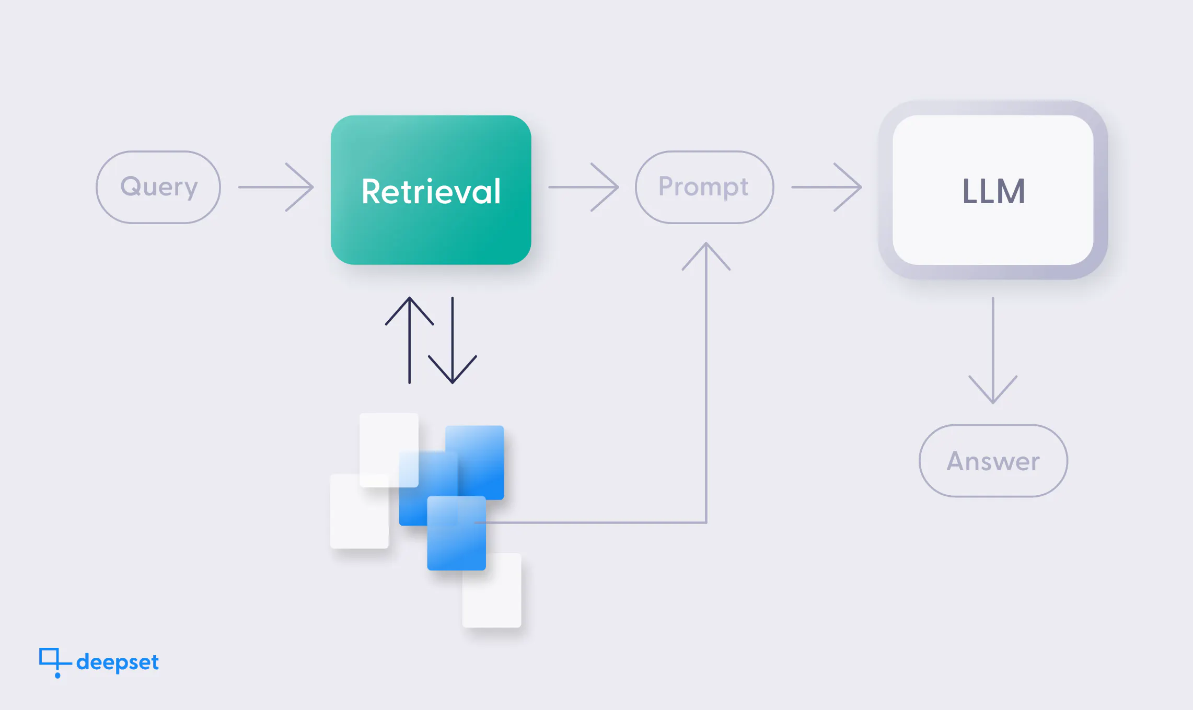
Different training approaches
1. Cumulative fine-tuning
2. Separate fine-tuning.
Retrain

Slide 43
How Can we Create Time Series using user generated data.
Ask Ai the same question we have asked people
If you train the model with data upto a point we get different result base on the time
If you ploat the result, you get time series showing the pinion change base on different time

Slide 44
Method of quarying
querying approach:
Continue pretraining on the tweets with a masked language modeling goal.

Slide 45
TwHIN-BERT
Sample size:
7 billion Tweets in 100 languages from Jan. 2020 to Jun. 2022.
Additionally, 100 billion user-tweet social engagement data covers 1 billion of our Tweets.
Traning:
The training has two stages.
we train the model from scratch using the 6 billion Tweets without user engagement. The model is trained for 500K steps with a total batch size of 6K.
The model is trained for another 500K steps on the 1 billion Tweets with the joint MLM and social loss. Using TwHIN.

Slide 46
Training
Pre-processing
Concatenate all the sequences
Split the concatenated sequences into shorter chunks defined by block_size of 128 word, which should be both shorter than the maximum input length and short enough for your GPU RAM.
Why concatenate everything together? The reason is that individual examples might get truncated if they’re too long, and that would result in losing information that might be useful for the language modeling task!
Tokanize the data using auto tokenizer.
Randomly mask 15 percent of word.

Slide 47
Results
Perplexity:
 | Before Training | After Training | Difference before - after | Evaluation | Size
Height | 21,34 | 9,48 | 14,04 | 9,97 | 137837
Lowest | 17,27 | 6,41 | 8,81 | 8,85 | 24602
Difference | 4,07 | 3,07 | 5,22 | 1,11 | 113235
Peak points:
2019 – 32 when first News started to come
2020-19 Height Perplexity at covid first wave

Slide 48
Question
Broadly speaking, which of the following best describe your mood and/or how you have felt in the past week. Please select all that apply <mask>.
 | 2019_23 | 2019_24 | 2019_25 | 2019_26
Sad | 1,45E+00 | 1,88E-01 | 4,74E-01 | 2,14E-01
Content | 1,13E+00 | 2,31E-01 | 3,97E-01 | 6,60E-01
Other | 4,79E-01 | 2,10E-01 | 4,92E-01 | 1,07E-01
Stressed | 3,30E-01 | 2,77E-01 | 1,52E-01 | 1,72E-01
Lonely | 2,58E-01 | 8,43E-02 | 3,15E-01 | 4,76E-02

Slide 49
outcomes

Slide 50
Next steps

Slide 51
The problem with current approach
Still dependent on the query. A slight change is query can give a completely different results.
Both result have some amount of time lag. The lag between actual emotion and time survey result come or the time the model train and adapt according to the emotion can be varied.
Result is not consistent with all query. It is giving quite similar result for some variable, but for other variable it is way different from the survey result.
If it has been working for one survey, it is not certain that it going to work for another survey.
Try other approach to see if it perform better.

